Slide 1
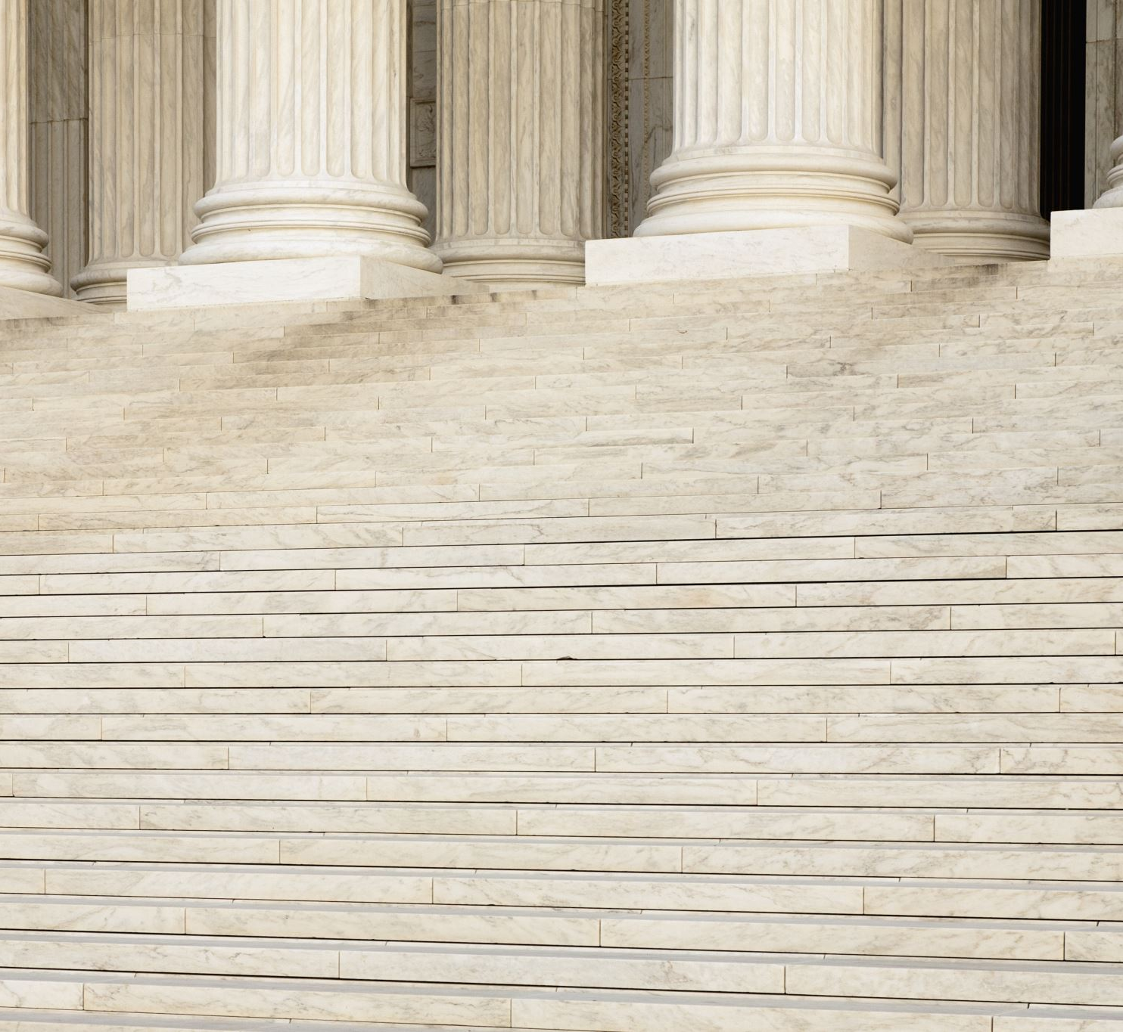
Doctrine of Precedent

Slide 2
Learning Intentions
Success Criteria

Slide 3
The Role of the Judge
New and unusual cases come up in Australian courts every day and sometimes the parliament made, statutory law is not clear about how a particular case should be dealt with.
So a judge from a superior court must make a decision on how to resolve the issue in a fair and just way.
This decision sets a precedent.

Slide 4
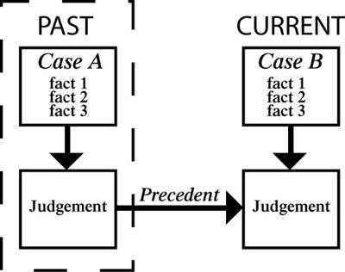
What is a Precedent?
A precedent means that any similar cases in the future should be dealt with in the same way.
Notes:
Image sourced from Lawgovpol.com

Slide 5
Understanding Precedent
To understand the system of precent, think about these school incidents.
Case 1: You arrive late to school because you slept in. Your teacher gives you detention.
Case 2: Your friend arrives late to school because she slept in. The teacher uses case 1 as a precedent.

Slide 6
Question 1.
Should the teacher give your friend a detention?
Why?

Slide 7
Answer
These are the same circumstances, so the decision should be consistent.
GIVE A DETENTION.

Slide 8
Case 3:
Your friend arrives late the next day because the school bus broke down.

Slide 9
Question 2:
Should the teacher use Case 1 and Case 2 as precedents and give a detention? Why?

Slide 10
Answer:
This is different because it was not the student’s fault.
Cases 1 and 2 are not precedents for Case 3.
NO DETENTION.

Slide 11
Case 4:
You are your friend arrive late because you thought the bus was still broken down (but it had been fixed), so you just took your time to get there.

Slide 12
Question 3:
Are Cases 1, 2 or 3 precedents for this situation?
Should the teacher give you a detention?
Why?

Slide 13
Answer
Cases 1 and 2 are precedents because being late was your fault.
DETENTION

Slide 14
Case 5:
You leave school early because you are bored with school.

Slide 15
Question 4:
Can Case 1 be used as a precedent for deciding whether or not to give you a detention?
Why?

Slide 16
Answer
Case 1 is a precedent, because it and this case are both about you not being at school through your own faut. It does not matter that Case 1 is about arriving late ad Case 5 is about leaving early as the principles is the same.
DETENTION

Slide 17
How does this relate to Common Law?
Among other things, judges look at cases from the past that are similar in facts or principle to make decisions about penalty. A judge is a theft case might make a decision based on a case that happened hundreds of years ago.
Alternatively, although the facts are similar – for example, both cases might involve stealing a loaf of bread – the judge may decide that different conditions in society then and now mean that today’s case should not be decided in the same way.

Slide 18
Common law is the law developed by judges over time, based on decisions in previous cases.
These decisions are recorded in special law report books to which lawyers can refer to argue their cases and judges can refer to make their decisions.
It is only the decisions of the highest and most important courts that are recorded and referred to in this way.

Slide 19
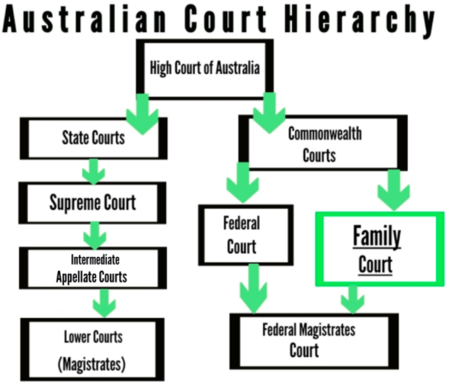
The court’s version or interpretation of the law is the ratio decidendi (the reason behind the decision) and binding direction for future judges; the expectation means that lower courts follow the binding precedent based on the reasoning of higher court decisions.
Notes:
Image and text sourced from https://unistuff977075235.wordpress.com/

Slide 20
Which of the following best describes the legal system of Australia?
Appeals flow down and precedents flow up.
Precedents are initiated by parliament.
Precedents flow down and appeals flow up.
Appeals are only heard by the Federal Court.

Slide 21
Which of the following best describes the legal system of Australia?
Appeals flow down and precedents flow up.
Precedents are initiated by parliament.
Precedents flow down and appeals flow up.
Appeals are only heard by the Federal Court.

Slide 22
What is the meaning of ‘on the balance of probabilities’?
The judge believes that there is sufficient evidence to show that it is likely the defendant harmed the plaintiff in some way.
It is believed that the plaintiff is guilty beyond reasonable doubt of the accusations against them.
The jury has convicted the accused based on the evidence presented to them by the prosecution.
The offender is more than likely to re-offend and imprisonment is the best option for sentencing and providing compensation.

Slide 23
What is the meaning of ‘on the balance of probabilities’?
The judge believes that there is sufficient evidence to show that it is likely the defendant harmed the plaintiff in some way.
It is believed that the plaintiff is guilty beyond reasonable doubt of the accusations against them.
The jury has convicted the accused based on the evidence presented to them by the prosecution.
The offender is more than likely to re-offend and imprisonment is the best option for sentencing and providing compensation.

Slide 24
What is meant by the phrase ‘the punishment must fit the crime’?
The plaintiff must pay just compensation for their actions.
Offenders have to go to jail for justice to be done.
The sentence of the court should not be too harsh nor too lenient.
The defendant must attend mediation before going to court.

Slide 25
What is meant by the phrase ‘the punishment must fit the crime’?
The plaintiff must pay just compensation for their actions.
Offenders have to go to jail for justice to be done.
The sentence of the court should not be too harsh nor too lenient.
The defendant must attend mediation before going to court.

Slide 26
Which of the following is not an example of a civil dispute?
throwing a brick through a shop window
not following through on an agreement to buy a car
writing a blog which includes falsehoods about a person or their character
leaving electrical wiring exposed without leaving appropriate warning signs

Slide 27
Which of the following is not an example of a civil dispute?
throwing a brick through a shop window
not following through on an agreement to buy a car
writing a blog which includes falsehoods about a person or their character
leaving electrical wiring exposed without leaving appropriate warning signs

Slide 28
Which is the most correct reason for the hierarchy of courts in Australia?
It follows the principles of the separation of powers by providing separation of church and state.
There is a need to separate cases, so they are dealt with before precedent expires.
When Australia became a country, the Westminster system was adopted and never changed.
It allows for specialist knowledge and efficiency in dealing with legal matters.

Slide 29
Which is the most correct reason for the hierarchy of courts in Australia?
It follows the principles of the separation of powers by providing separation of church and state.
There is a need to separate cases, so they are dealt with before precedent expires.
When Australia became a country, the Westminster system was adopted and never changed.
It allows for specialist knowledge and efficiency in dealing with legal matters.

